Slide 1
Capstone Project
Online Retail Customer Segmentation
Unsupervised Machine Learning BY Shubhashis Singh

Slide 2

Problem Statements
➢ The problem is to identify major customer segments on a transnational data set which
contains all the transactions occurring between 01/12/2010 and 09/12/2011 for a UK-based
and registered non-store online retail.
➢ The company mainly sells unique all-occasion
gifts.
➢ Many customers of the company are
wholesalers.

Slide 3

What is Customer Segmentation?
➢ Customer segmentation is the process of separating customers into groups based on their shared behaviour or other attributes. The groups should be homogeneous within themselves and should also be heterogeneous to each other.
➢ The main goal is to identify customers that are most profitable and the ones who churned out to prevent further loss of customer by redefining company policies.
➢ Having large number of customers, each with different needs it is crucial to find which customer are most important for business and target them with appropriate strategy.

Slide 4
Data Description
➢ InvoiceNo: Invoice number. Nominal, a 6-digit integral number uniquely assigned to each
transaction. If this code starts with letter 'c', it indicates a cancellation.
➢ StockCode: Product (item) code. Nominal, a 5-digit integral number uniquely assigned to each
distinct product.
➢ Description: Product (item) name. Nominal.
➢ Quantity: The quantities of each product (item) per transaction. Numeric.
➢ InvoiceDate: Invoice Date and time. Numeric, the day and time when each transaction was
generated.
➢ UnitPrice: Unit price. Numeric, Product price per unit in sterling.
➢ CustomerID: Customer number. Nominal, a 5-digit integral number uniquely assigned to each customer.
➢ Country: Country name. Nominal, the name of the country where each customer resides.

Slide 5
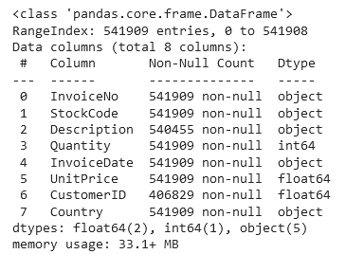
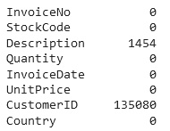
Data Wrangling
➢ Info of the Data ➢ Null values
We had Drop all missing datapoint for
Notes correct model building.
1.Invoicedate to Datetime
2.Where Invoiceno Starts with
C it means Cancellation.

Slide 6
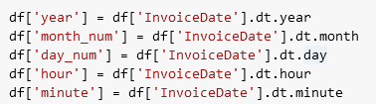
Feature Engineering:
➢ Changed the datatype of Invoice Date column into datetime .

Slide 7
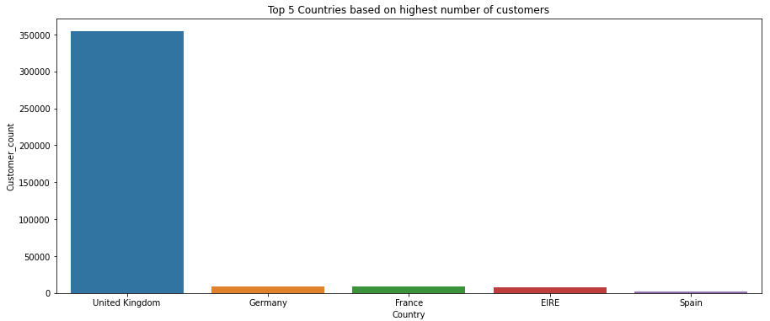
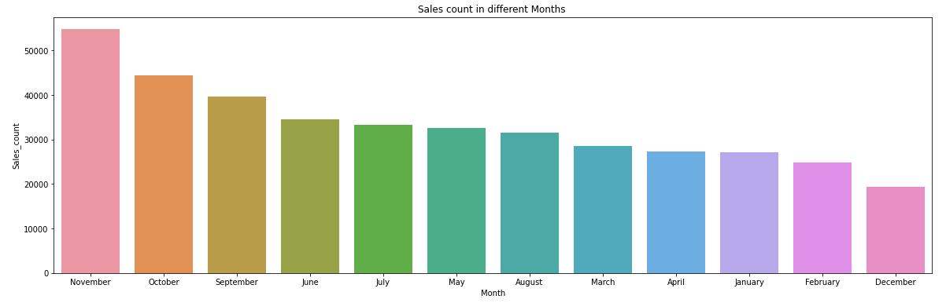
EDA
Top 5 countries Transaction per Month
➢ UK has highest number of customers. ➢ Most of the sale happened in November Month .
➢Germany,France and IreLand has almost ➢ December Month had least sales.
equal number of customers.

Slide 8
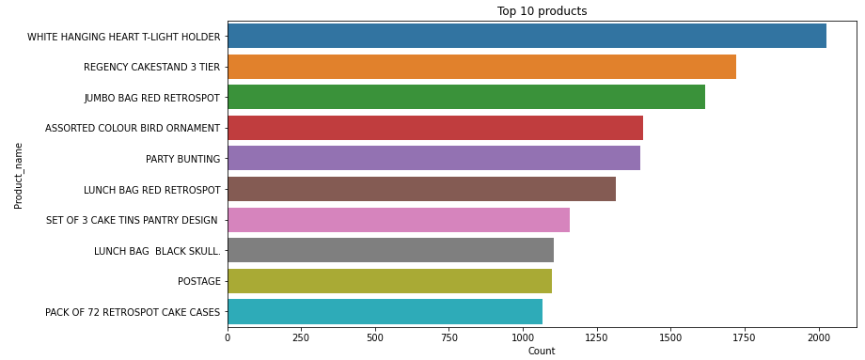
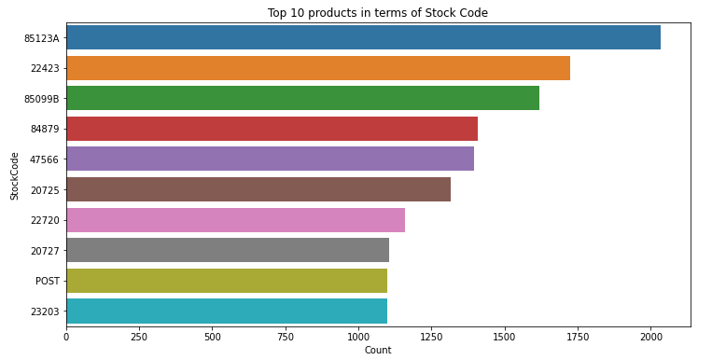
Top 10 Products(Description wise)
• WHITE HANGING HEART T- LIGHT HOLDER is the highest selling product almost 2018 units were sold.
• REGENCY CAKESTAND 3 TIER is the 2nd highest selling product almost 1723
units were sold.
Top 10 products(Stock Code wise)
• StockCode-85123A is the first highest selling product. • StockCode-22423 is the 2nd highest selling product.

Slide 9
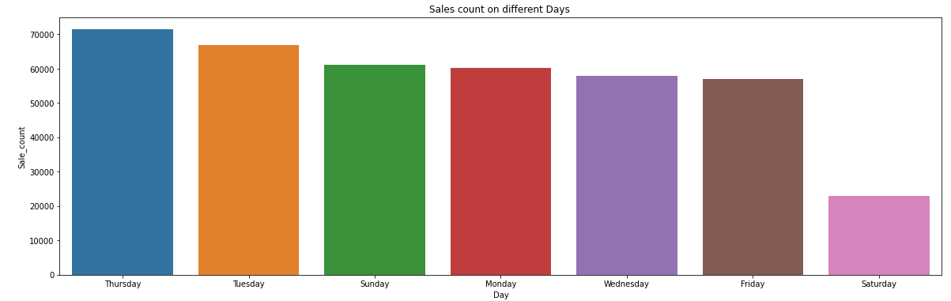
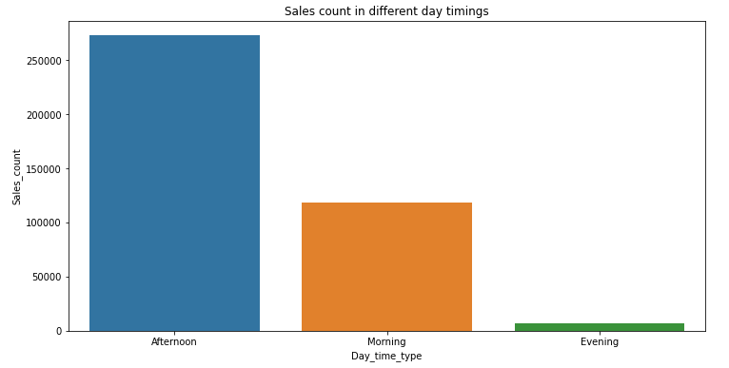
Day wise sale count Day time sale
➢ Sales On Thursdays are very high. ➢ Most of the sales happens in the afternoon.
➢ Sales On Saturday are very less. ➢ Least sales happens in the evening.

Slide 10
RFM Segmentation
What is RFM?
➢ RFM : is a method used to analyse customer value. RFM stands for RECENCY, Frequency, and Monetary.
➢ RECENCY : How recently did the customer visit our website or how recently did a customer purchase?
➢ Frequency : How often do they visit or how often do they purchase?
➢ Monetary : How much revenue we get from their visit or how much do they spend when they purchase?
Why it is Needed?
RFM Analysis is a marketing framework that is used to understand and analyse customer behaviour based on the above three factors RECENCY, Frequency, and Monetary. The RFM Analysis will help the businesses to segment their customer base into different homogenous groups so that they can engage with each group with different targeted marketing strategies.

Slide 11
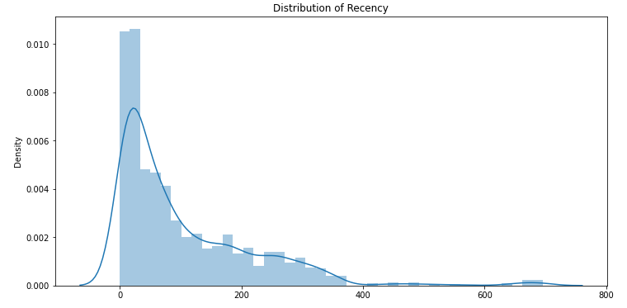
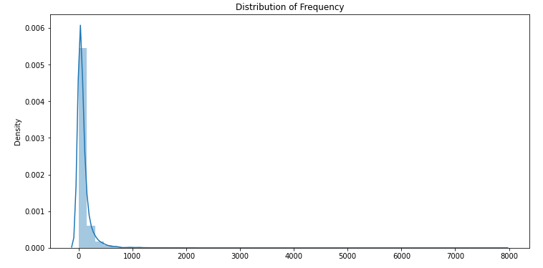
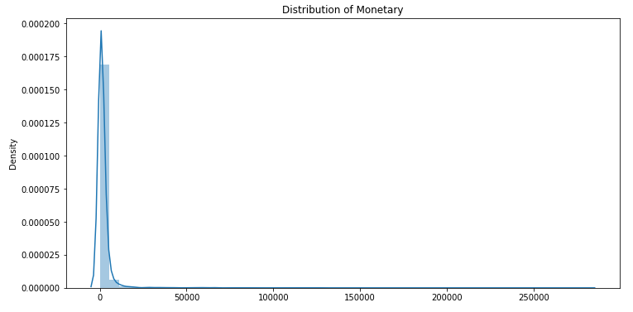
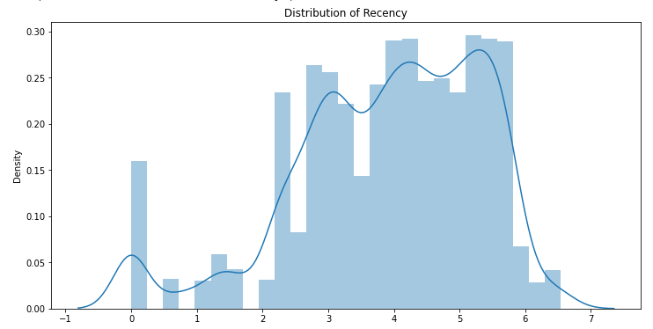
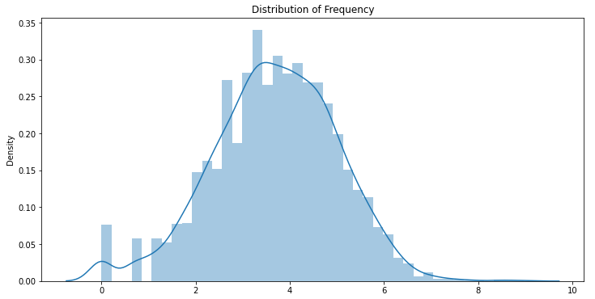
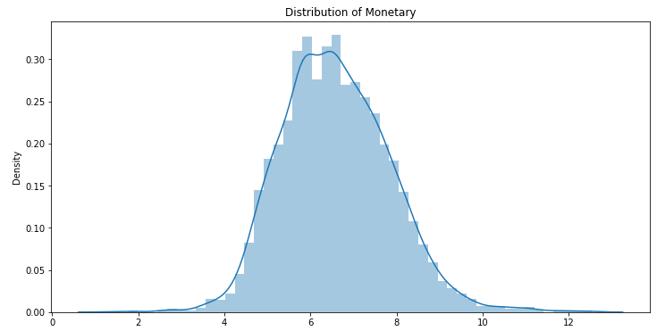
RFM Model Analysis:
Log transformation on Frequency, Recency and Monetary.

Slide 12
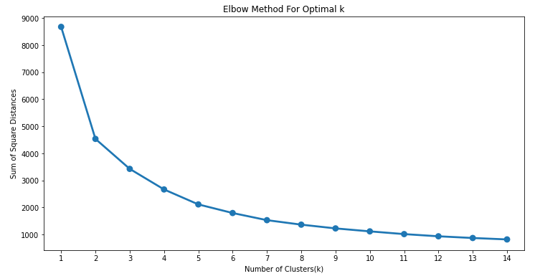
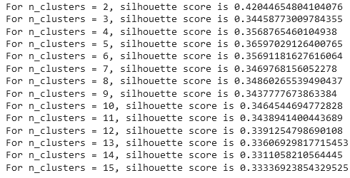
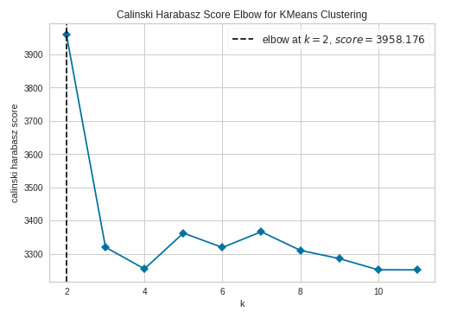
K-means Clustering: ( Recency and Monetary)

Slide 13
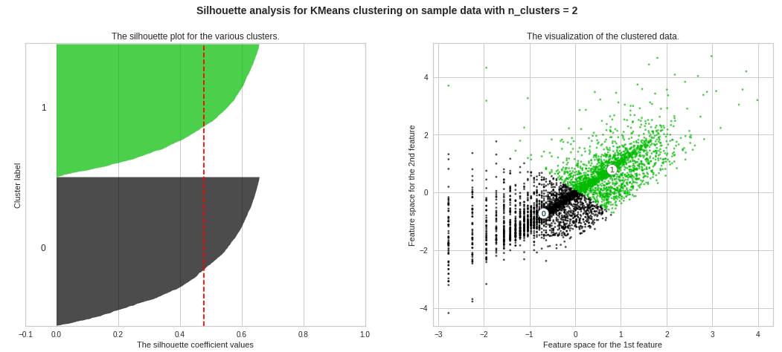
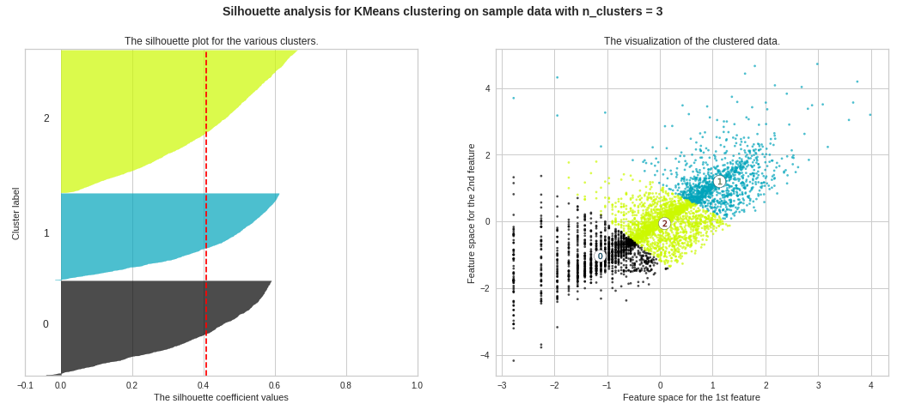
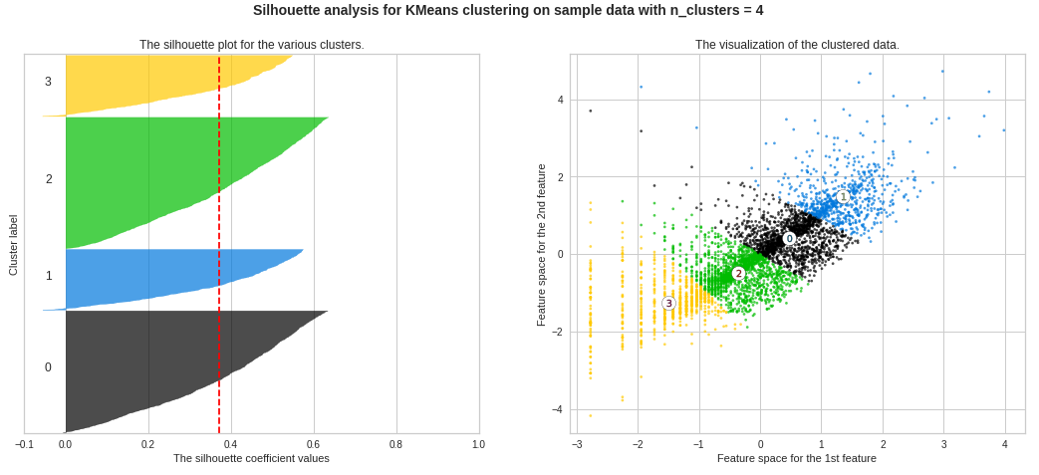
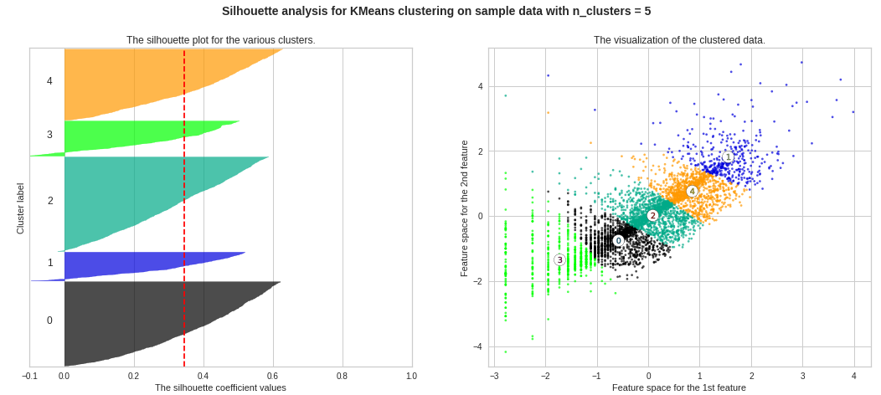

Slide 14
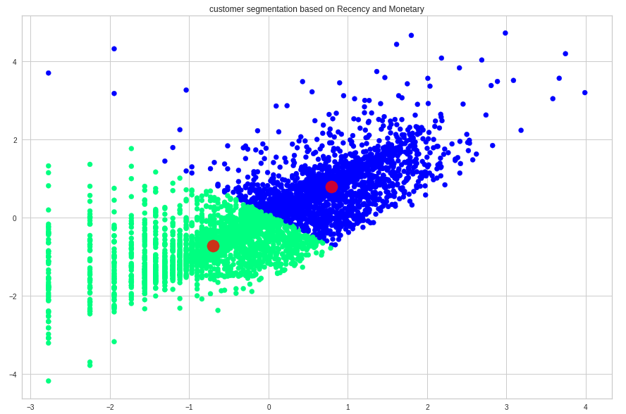
So giving n_clusters=2 on Kmeans Model.

Slide 15
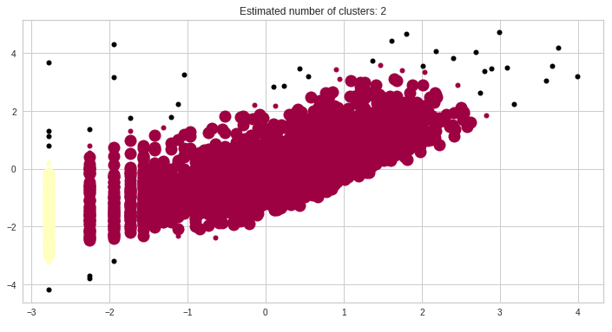
DBSCAN Algorithm on Recency,Frequency and Monetary

Slide 16
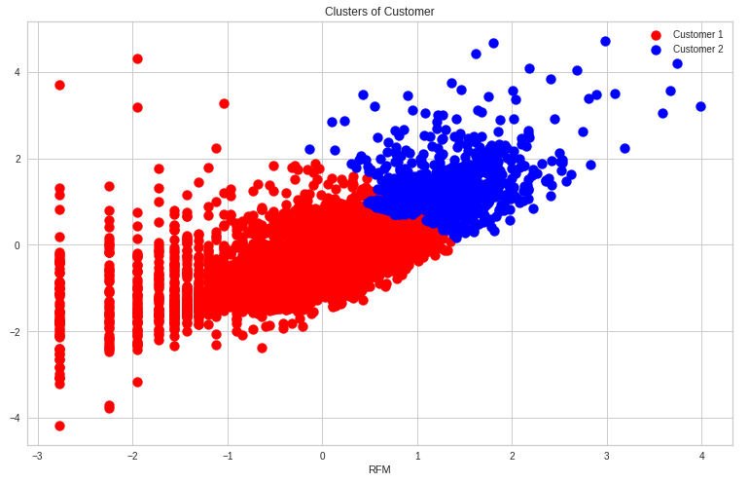
Hierarchical Clustering

Slide 17
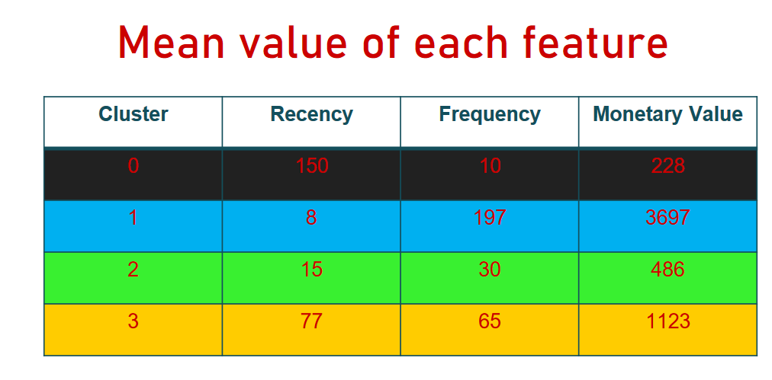

Slide 18
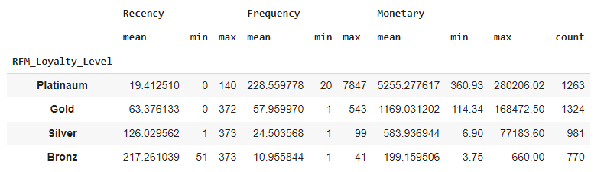
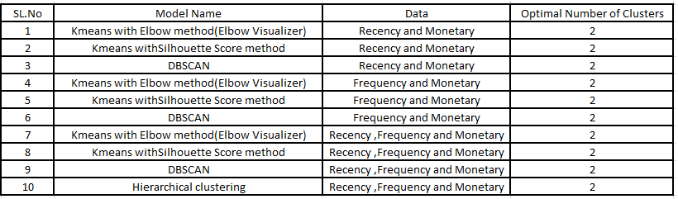
Summary and Conclusion:
Firstly we did clustering based on RFM analysis. We had 4 clusters/Segmentation of customers based on RFM score.
➢ Platinum customers=1263 ( less recency but high frequency and heavy spendings)
➢ Gold customers=1324 (good recency,frequncy and moentary)
➢ Silver customers=981(high recency, low frequency and low spendings)
➢ Bronz customers=770 (very high recency but very less frequency and spendings)
Later we implemented the machine
learning algorithms to cluster the
customers.

Slide 19
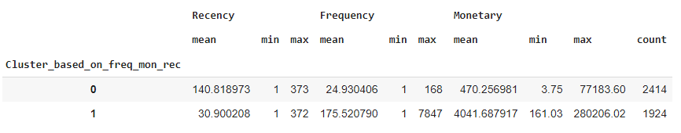
Summary and Conclusion:
➢ Above clustering is done with recency,frequency and monetary data(Kmeans Clustering) as all 3 together will
provide more information.
➢ Cluster 0 has high recency rate but very low frequency and monetary. Cluster 0 contains 2414 customers.
➢ Cluster 1 has low recency rate but they are frequent buyers and spends very high money than other
customers as mean monetary value is very high. Thus generates more revenue to the retail business

Slide 20
